Slide 1
Crack modelling with FNM
Harshwardhan Praveen (under guidance of Dr. Syed Nizamuddin Khaderi and Dr. Ramji M.)
ME15BTECH11015

Slide 2
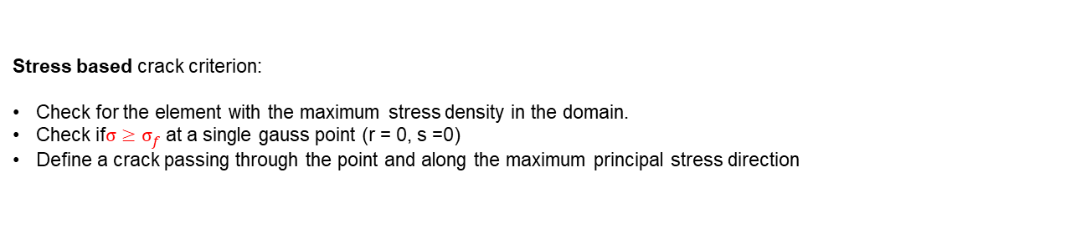
Crack propagation criterion
Stress based crack criterion:
Check for the element with the maximum stress density in the domain.
Check if$σ≥σ_{f}$ at a single gauss point (r = 0, s =0)
Define a crack passing through the point and along the maximum principal stress direction
r = 0 s = 0
Figure 1: Crack from a side to a side opposite to it

Slide 3
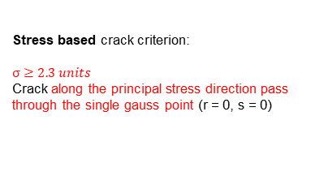
Benchmarking – Induced cracks
10
`
0.5
Stress based crack criterion:
$$σ≥2.3 units$$
Crack along the principal stress direction pass through the single gauss point (r = 0, s = 0)
10
y
x
|v| = 0.5
Induced crack
At t = 20 at an offset 0.5 from the centre
|v| = 0.5
E = 1
Density = 1
Damping coefficient = 0.5

Slide 4
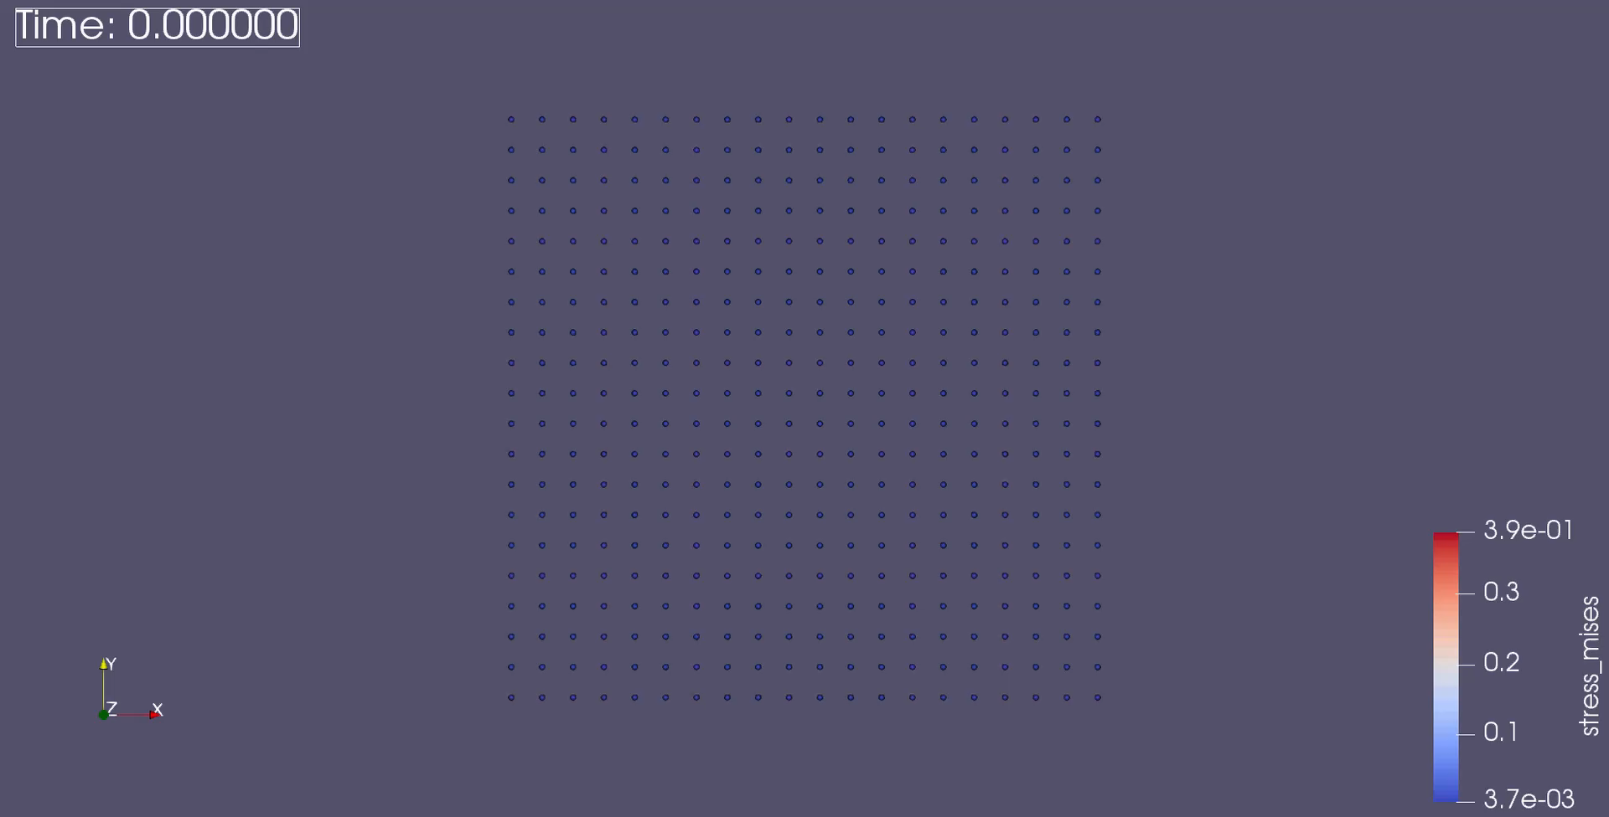
Benchmarking – Induced cracks
Figure 1: Crack propagating in a square plate along the middle line

Slide 5
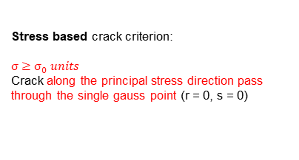
Benchmarking – Induced cracks
150
|v| = 0.01
`
Stress based crack criterion:
$$σ≥σ_{0} units$$
Crack along the principal stress direction pass through the single gauss point (r = 0, s = 0)
R15
E = 1
Density = 1
200
10
20
55
y
x
|v| = 0.01

Slide 6
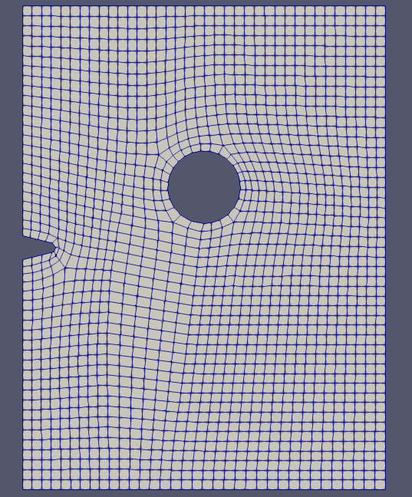
Benchmarking – Stress on a plate with notch

Slide 7
Future plan
Finish current benchmarks.
Find and implement a better crack criterion.
Implement extra functionality for unstructured meshes.
Applying this formulation for composites.

Slide 8
Thank you!

Slide 9
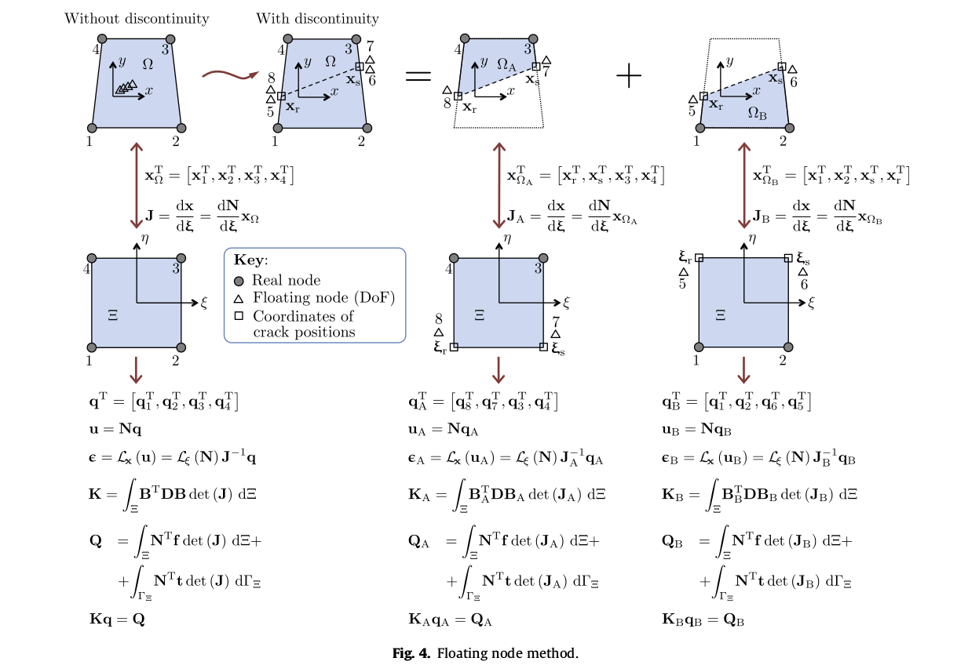
Floating Node Method
Reference: A floating node method for the modelling of discontinuities in composites (Chen et al)

Slide 10
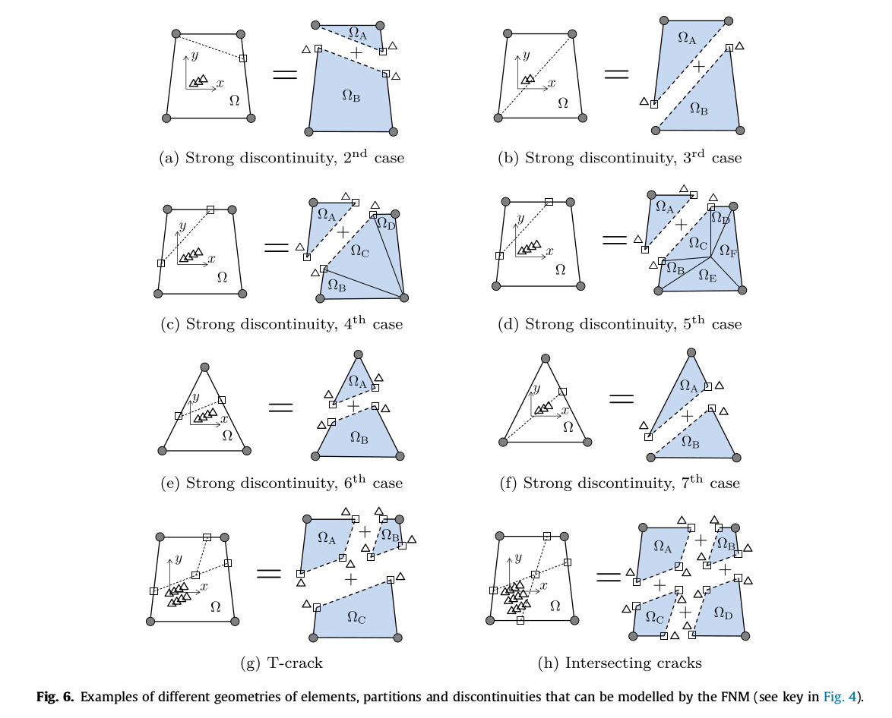
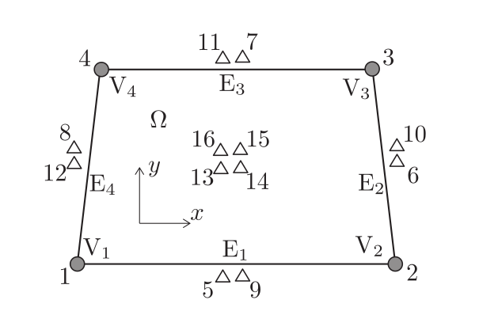
Floating Node Method - Crack representation
Figure 1: Example of local DoF, vertices and edges numbering for the FN element
Figure 2: Different geometries of elements, partitions and discontinuities
Reference: A floating node method for the modelling of discontinuities in composites (Chen et al)

Slide 11
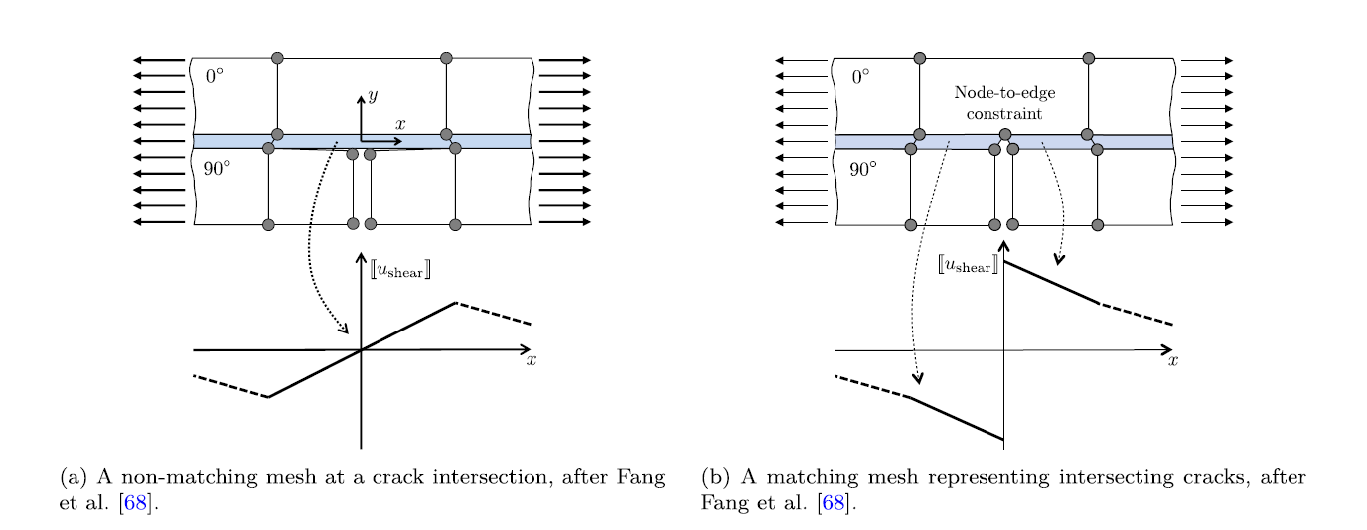
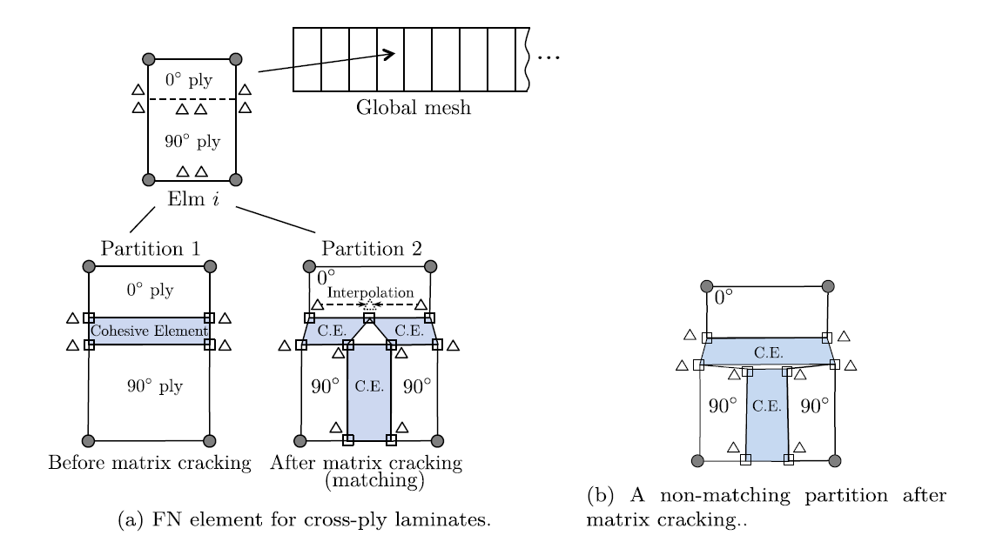
Floating Node Method - Composite laminates
Figure 1: Non matching mesh (fails to capture displacement jump across the crack tip
Figure 2: Matching mesh (captures the displacement jump across the crack tip
Figure 3: FN element formulation for cross-ply composites
Reference: A floating node method for the modelling of discontinuities in composites (Chen et al)

Slide 12
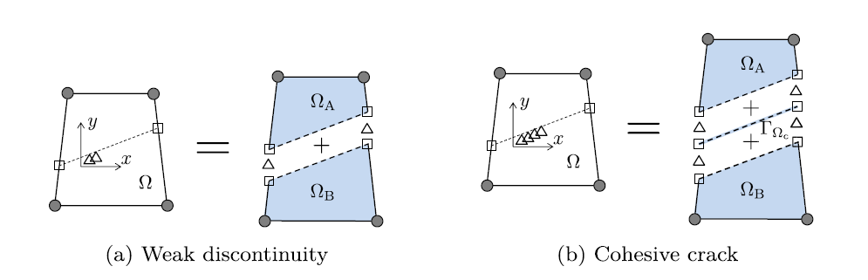
Floating Node Method - Weak/Cohesive Discontinuities
Weak Discontinuity:
Represented in an analogous way to strong discontinuity but with a few nodes being defined along the line of discontinuity.
Cohesive Discontinuity:
Represented by partitioning the domain into two parts and a surface.
Figure 1: Weak discontinuity
Figure 3: Strong Discontinuity
Reference: A floating node method for the modelling of discontinuities in composites (Chen et al)

Slide 13
Approach for FNM implementation
Edge status variable
-1 if there is no discontinuity
0 if the edge has a tip of a discontinuity
1 if the discontinuity has crossed the edge
Check if the element has a discontinuity by check the edge dataset.
Intersection location variable
The natural coordinate of intersection of the discontinuity along the edge
Based on the location of discontinuity, activate the additional nodes.
Discontinuity absent
Standard FEM code for quads
Discontinuity present
Split the element in to the required number of sub-elements and calculate the stiffness matrix individually.
Assemble the stiffness matrix for sub-elements into the element and return it to the global assembly process.

Slide 14
Cracking cases modelled
2
1
3
1
2
4
Figure 2: Crack from a side to a side adjacent to it
Figure 1: Crack from a side to a side opposite to it
1
2
1
2
3
3
4
Figure 3: T-crack
Figure 4: Intersecting cracks

Slide 15
Stepwise approach to solution
Implement standard 2D FE code and benchmark it.
Implement the Floating Node method.
Benchmark the code against different basic problems
Implement crack propagation

Slide 16
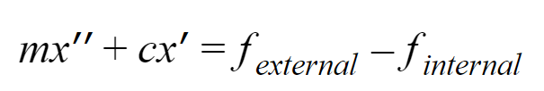


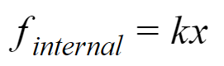

Equations being solved
The solver is a basic dynamic-explicit solver with integration using forward euler.

